Slide 1
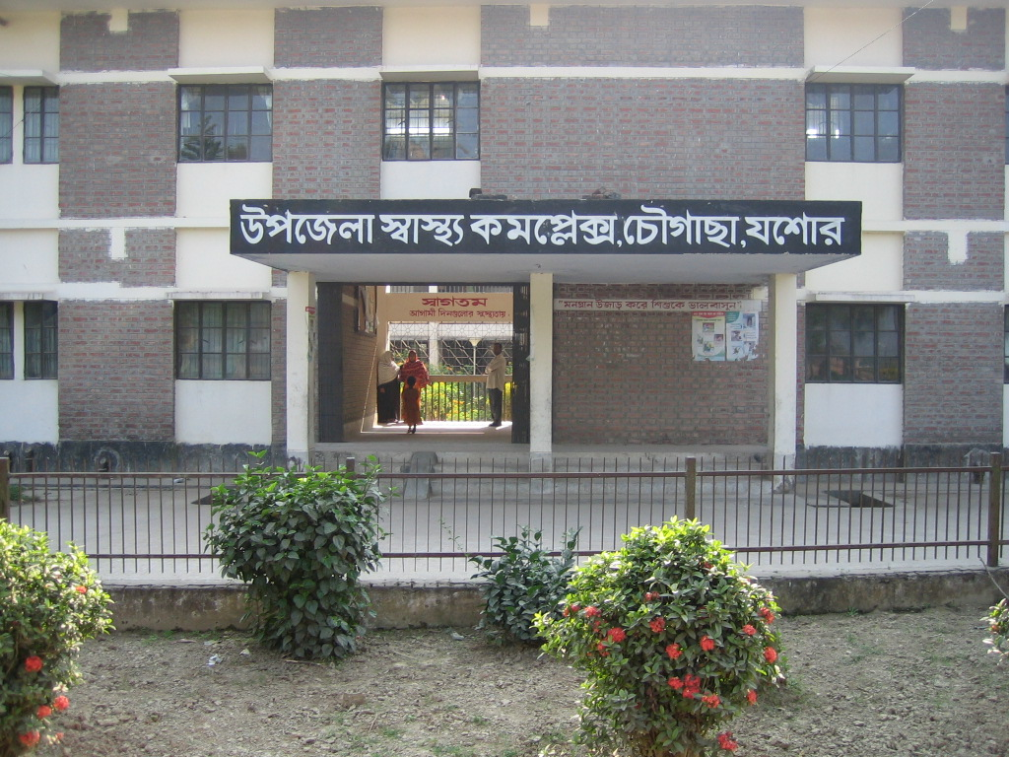
Chowgacha Health Complex:
A model EMOC Service centre of Upzila level in Bangladesh.
Dr. Emdadul Haque
Jn. Consultant (Obst & Gynae)

Slide 2
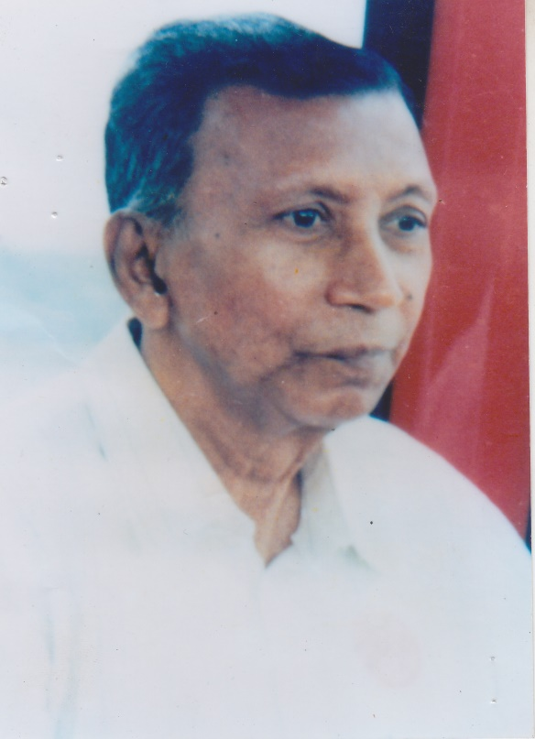
“During the marriage of your daughter you should mansion a precondition in Kabinnama that your daughter should delivered her baby in Hospital”
Prof. Dr. Moklechur Rahman

Slide 3
Basic National Health Indicators
IMR (per thousand LB) 52
MMR (per thousand LB) 3.2
NMR (per thousand LB) 37
Under 5 MR (per thousand LB) 65
Crude birth rate (per thousand pop.) 20.9
Crude death rate (per thousand pop.) 6.2
Population growth rate (%) 1.4
Total fertility rate (birth per women) 2.7
Life expectancy at birth Male 65.4 yrs
Female 67.9 yrs
Source: Health Bulletin 2009, MIS,DGHS

Slide 4
MDG 4 and 5 Achieved in Chowgacha2010.
Per 1000 live Birth Chowgacha MDG Target National
MMR: .42 1.47 3.2
(MDG 5 Achieved)
IMR: 23.9 31 52
(MDG 4 Achieved)
<5 MR: 25.8 50 65
(MDG 4 Achieved)

Slide 5
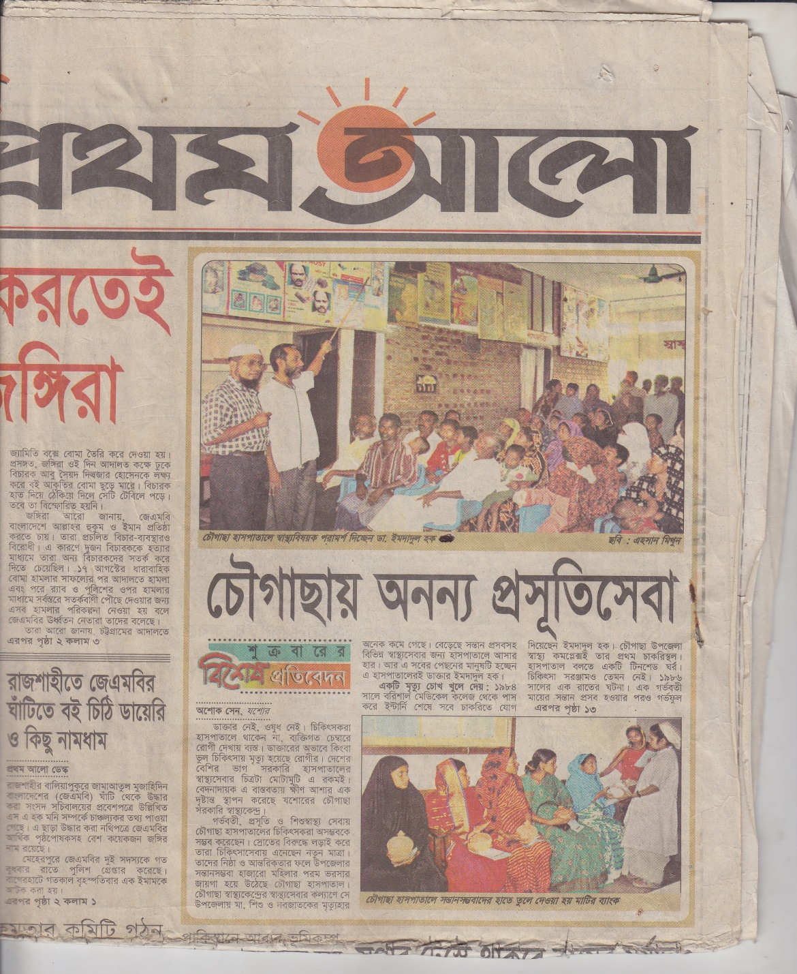
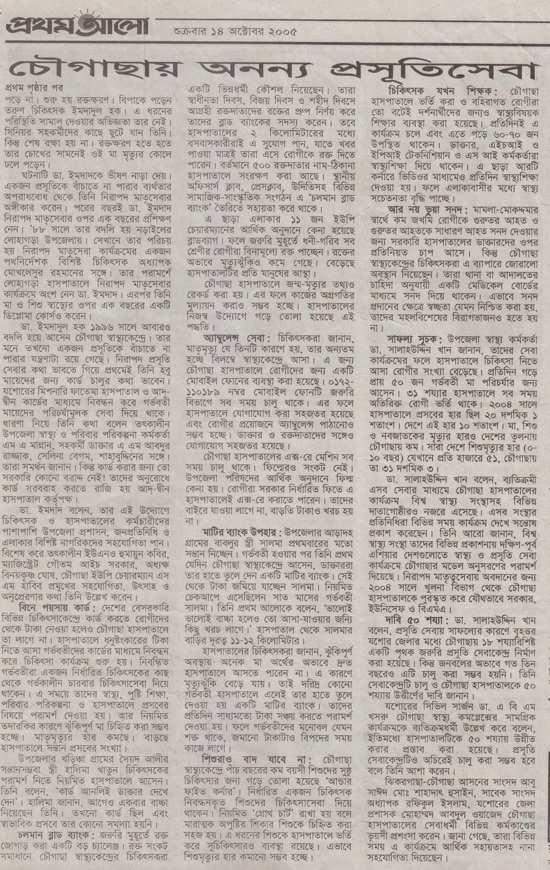

Slide 6
Thank you

